Slide 1
Group 16 Data-Driven Strategies to Unlock Future Growth Potential: A Predictive Marketing Analytics Approach
-by
(Group 16)
Daniel Bond dab200000
Manoj Mareedu mxm220069
Yashasvi Pamu yxp220001
Nallam Paramkousam Nallam nxn220021
Pooja Reddy Donda pxd210043

Slide 2
Executive Summary
Objective: Analyze table spread sales data to identify trends in regionality, seasonality, brand effects, price elasticity, and the impact of COVID-19.
Findings: Over three years, there was a decrease in brand count, an increase in mean dollar sales and price per unit, and a inconsistent units sold pattern.
Model: A linear regression model was developed to identify the impact of various variables on units sold without merchandising, with the Southeast and Northeast regions having the best effect on sales, while the Plains region had the worst.
Hypothesis Testing: Differences in units sold between years were significant, and an ANOVA test showed significant differences in unit sales between regions for each year.
Recommendations: Focus on studying the Northeast, Southeast, and Plains regions to understand what makes them successful or unsuccessful. Consider not raising prices or lowering them slightly to gain customer goodwill and prioritize the BlueBonnet brand over Smart Balance. Monitor the Imperial RFG and Private Label brands.
Linear Regression Equation: Unit Sales No Merch = (Base Volume Sales) + (Price per Unit No Merch) + (Price per Unit Any Merch) + (ACV Weighted Distribution No Merch) + (ACV Weighted Distribution Any Merch) + (Brands) + (Regions) + (Years).

Slide 3
Introduction
Conagra Brands seeks to optimize their brand portfolio and accelerate growth
Four questions to answer: regionality, seasonality, brand effect, price elasticity
Identify regions and brands that have significant effects on unit sales
Prioritize resources on high-performing regions and brands
Understand how years (2018, 2020, 2022) affected sales
Identify which brands had higher demand during crises
Analyze impact of prices on sales to adjust pricing strategies
Make data-driven decisions based on insights from the data

Slide 4
Preprocessing
Preprocessing data is crucial for data analysis to extract meaningful insights.
Our rigorous process involved replacing null values with zeros and removing duplicate entries.
We extracted year and brand name and created separate columns for each, adding dummy variables for brands, years, and geography.
We merged datasets from 2018, 2020, and 2022 to examine the impact of COVID-19 on sales during pre-crisis, crisis, and post-crisis periods.
We excluded 2019 and 2021 to maintain relevance and ensure accurate findings.
Preparing data accurately is critical for making informed decisions and taking appropriate actions.

Slide 5
Exploratory Data Analysis
We looked at the summary statistics for 2018,2020,2022
Noticed that the count for observations steadily went down.
This could be from brands being dropped due to supply chain issues, low demand, or another unforeseen issue
For the means, Price per unit and Sales Dollars went up consistently from 2018 to 2022.
Unit sales no merch went up in 2020 but down in 2022 but still above 2018 levels.

Slide 6
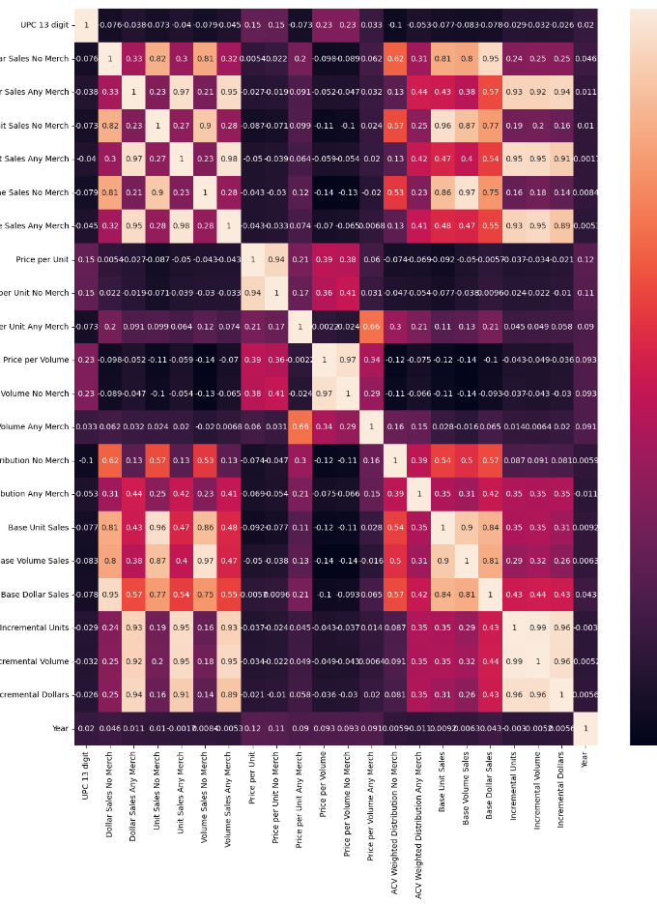
Correlation
No Merch and Any Merch variables had high correlation with themselves, but little correlation with price per unit variables.
No Merch Dollar Sales was highly correlated with Base Unit and Dollar Sales, while Any Merch was highly correlated with Incremental variables.
No merch and Any merch were somewhat correlated in cooking oils but not in table spreads, suggesting merchandising products may be helping non-merchandising variables.
Different regions were not correlated with any other variables.
Price per unit/volume of Any Merch and No Merch were not highly correlated with any other variables, which is unexpected.
Final formula: Unit sales no merch = Base Volume Sales + Price per Unit No Merch + Price per Unit Any Merch + ACV Weighted Distribution No Merch + ACV Weighted Distribution Any Merch + Brands + Regions + Years

Slide 7
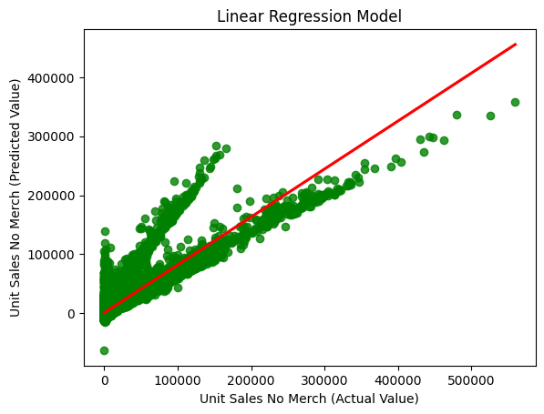
Linear Regression Model
Linear regression model used to analyze three years (2018, 2020, 2022) and effects of variables on unit sales no merch.
Price per unit no merch had a positive effect on unit sales while price per unit any merch had a negative effect.
ACV weighted distribution for both merch and non merch had less effect in magnitude than price, but any merch had negative effect.
Base volume sales, though highly correlated with unit sales no merch, had no real effect.
All regions had negative effects, but Southeast had least negative effect and Plains had most negative effect.
Brands had positive effect on unit sales but had less magnitude than regions.
Worst year was 2018 and least bad was 2022, but all years were still negative.
Additional years were included due to spillover observations from the original three years.

Slide 8
Hypothesis & Anova Test
Performed hypothesis tests to see if the change in Unit Sales No Merch for 2018,2020, 2022 was worth noting or not
All three years were significant
Anova test was conducted to see if the change in Unit Sales No Merch across the regions were significant over the three years
The changes were significant between the regions
Conagra should not disregard the changes over the years and regions

Slide 9
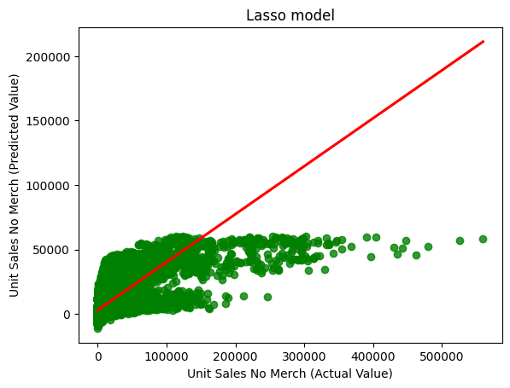
Lasso Model
Created to determine the significance of the various variables from the linear regression to see
Removed the Base Volume Sale in order to see what other variables were significant
We found these brands were quite significant: Blue Bonnet, Imperial RFG, Private Labels, and Smart Balance
North East and Plains were significant instead of the South East
Oddly, price per unit no merch was not significant and price per unit any merch was negatively significant
Only year 18 was significant but negatively

Slide 10
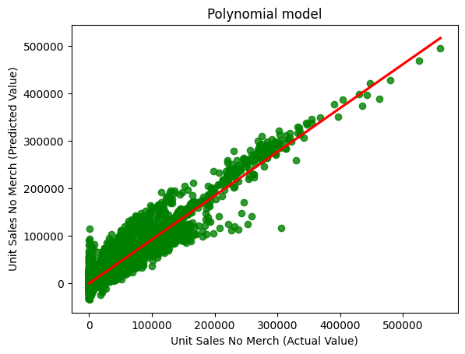
Polynomial
Created from the final formula and instead of using all brands, just the significant ones found in the Lasso
This was to see combinatorial effects of the variables
Then be used to make predictions for similar events for 2018,2020,2022

Slide 11
Conclusion
There was indeed regionality, there was a significant difference of Unit Sales No Merch between the regions (namely North & South East, and the Plains should be looked at)
There was seasonality, significant difference for the three years
For brands, Blue Bonnet, Imperial RFG, the private labels, and Smart Balance were significant using the Lasso model.
Conagra should study the Imperial brand first since it is a significant competitor and if possible the private labels though this could be tough due to they do not fall under any one business
Price elasticity, we noticed a pattern with the summary statistic but when using lasso, the Price Per Unit No Merch was not that significant though the Any Merch Counterpart was significantly negative
During the years tested, customers did not really care about the price so Conagra could think about lowering prices a little or even not raising them while others do. This could build good will with customers and take market share from other brands that do raise.

